Slide 1
Intent

Slide 2
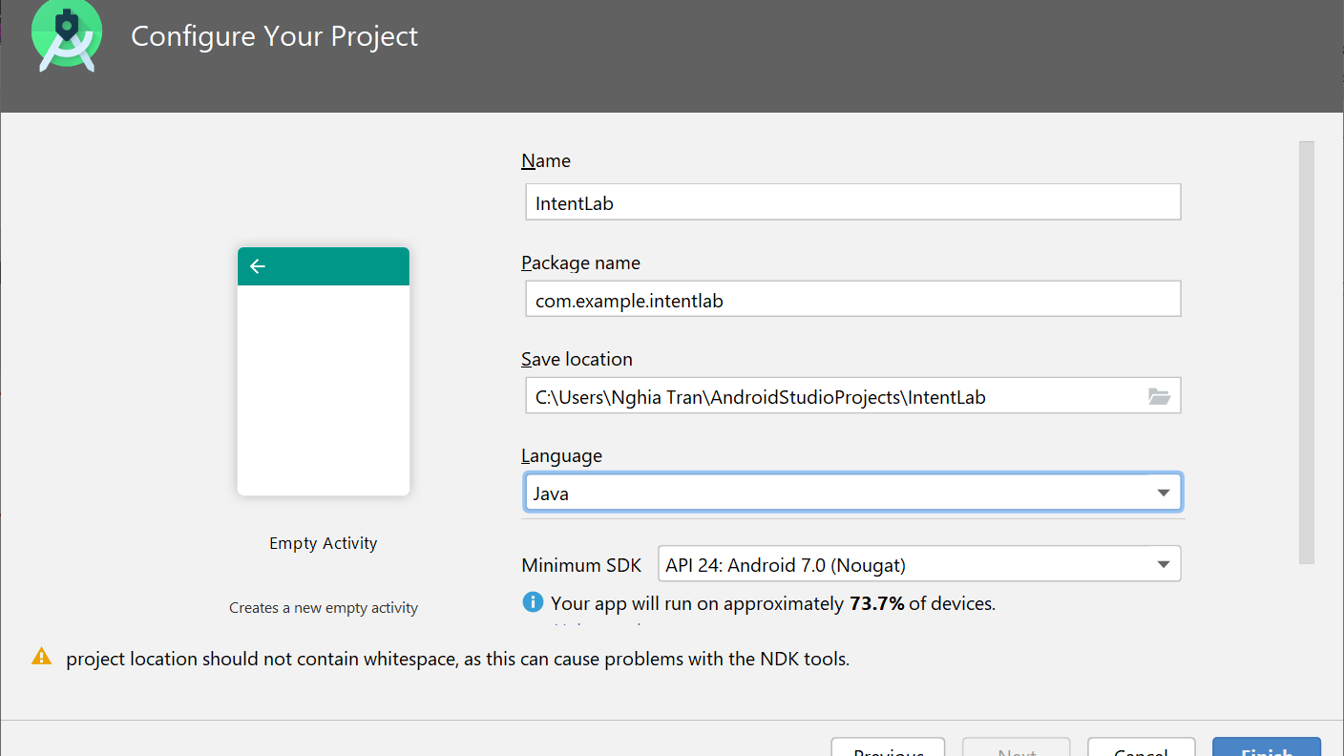

Slide 3
Thiết kế Views cho Main_Activity
<TextView android:layout_width="wrap_content" android:layout_height="wrap_content" android:text="Tên người dùng"/> <EditText android:layout_width="match_parent" android:layout_height="wrap_content" android:id="@+id/edtUsername"></EditText> <TextView android:layout_width="wrap_content" android:layout_height="wrap_content" android:text="Mật khẩu"/> <EditText android:layout_width="match_parent" android:layout_height="wrap_content" android:id="@+id/edtPassword" android:inputType="textPassword"></EditText> <Button android:layout_width="match_parent" android:layout_height="wrap_content" android:id="@+id/btnLogin" android:text="Đăng nhập"></Button>

Slide 4
Starting activity with Intent
Explicit activation
Implicit activation

Slide 5
Main_Activity.java - onCreate
Khai báo các đối tượng
Bổ sung vào onCreate
public class MainActivity extends AppCompatActivity { static private final int CODE_HELLO = 1; private EditText edtU = null; private EditText edtP = null; private Button btnLogin = null;
edtU = (EditText)findViewById(R.id.edtUsername); edtP = (EditText)findViewById(R.id.edtPassword); btnLogin = (Button)findViewById(R.id.btnLogin); btnLogin.setOnClickListener(new View.OnClickListener() { @Override public void onClick(View v) { if (checkPassword(edtU.getText().toString(), edtP.getText().toString())) { Intent intHello = new Intent(MainActivity.this, HelloActivity.class); startActivityForResult(intHello, CODE_HELLO); } } });

Slide 6
Main_Activity.java - onActivityResult
@Override protected void onActivityResult(int requestCode, int resultCode, Intent data) { if (requestCode == CODE_HELLO) { if (resultCode == RESULT_OK) { String s = data.getStringExtra("txt"); Toast.makeText(this, s, Toast.LENGTH_SHORT).show(); } } }

Slide 7
Add new Empty Activity - HelloActivity
<TextView android:layout_width="match_parent" android:layout_height="wrap_content" android:text="Xin chào! Bạn tên gì?"></TextView> <EditText android:layout_width="match_parent" android:layout_height="wrap_content" android:id="@+id/edtHello"></EditText> <Button android:layout_width="match_parent" android:layout_height="wrap_content" android:text="Xin chào" android:id="@+id/btnHello"></Button>

Slide 8
HelloActivity.java - onCreate
Button btn = (Button)findViewById(R.id.btnHello); btn.setOnClickListener(new View.OnClickListener() { @Override public void onClick(View v) { EditText edt = (EditText)findViewById(R.id.edtHello); Intent ret = new Intent(); ret.putExtra("txt", edt.getText().toString()); ret.setType("text/plan"); setResult(RESULT_OK, ret); finishActivity(CODE_HELLO); finish(); } });

Slide 9
Starting activity with Intent
Explicit activation
Implicit activation
Tạo ứng dụng TestBrowser
onCreate
String url = getIntent().getDataString(); if (url == null) url = "No Data Provided"; TextView textView = (TextView) findViewById(R.id.txtLink); textView.setText(url);

Slide 10
Starting activity with Intent
<activity android:name=".MainActivity"> <intent-filter> <action android:name="android.intent.action.MAIN" /> <category android:name="android.intent.category.LAUNCHER" /> </intent-filter> <intent-filter> <action android:name="android.intent.action.VIEW" /> <data android:scheme="http" android:host="*"></data> <category android:name="android.intent.category.DEFAULT"/> <category android:name="android.intent.category.BROWSABLE"/> </intent-filter> </activity>

Slide 11
Chỉnh sửa onClickListener
btnLogin.setOnClickListener(new View.OnClickListener() { @Override public void onClick(View v) { if (checkPassword(edtU.getText().toString(), edtP.getText().toString())) { Intent intHello = new Intent(MainActivity.this, HelloActivity.class); startActivityForResult(intHello, CODE_HELLO); } else { Uri page = Uri.parse("http://vnexpress.net"); Intent intWeb = new Intent(Intent.ACTION_VIEW, page); //startActivity(intWeb); Intent chooser = Intent.createChooser(intWeb, "Chọn App để gọi"); if (intWeb.resolveActivity(getPackageManager()) != null) { startActivity(chooser); } } } });

